Slide 1
Stabilization Loop
Final Project of Digital Control
오유성 (22400448), 이주영 (22200576)
Thanks to
나원상
Won-Sang Ra

Slide 2
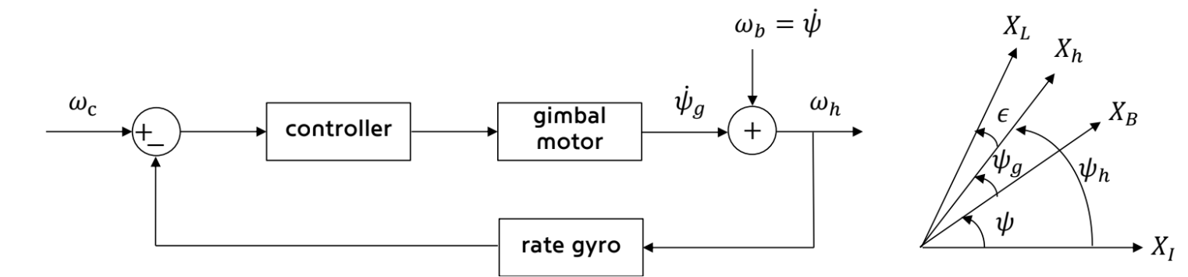
1. Stabilization Loop

Slide 3
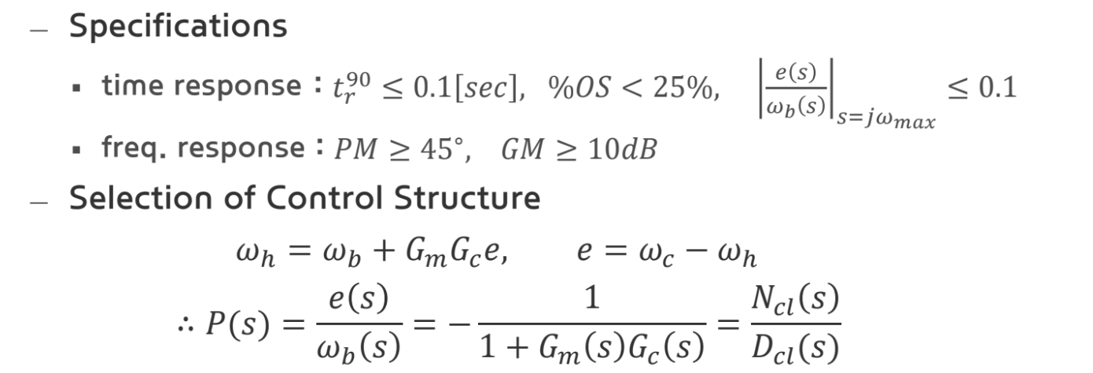
3. Design Procedures

Slide 4
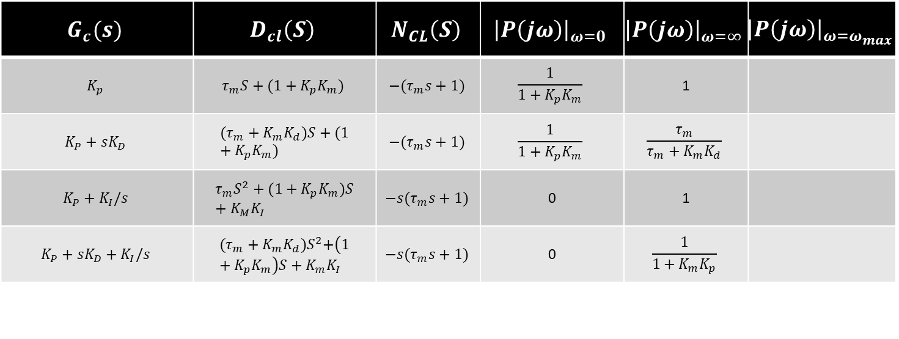
4. Design Procedures
$$G_{c}(s)$$ | $$D_{cl}\left(S\right)$$ | $$N_{CL}\left(S\right)$$ | $${\left|P\left(jω\right)\right|}_{ω=0}$$ | $${\left|P\left(jω\right)\right|}_{ω=∞}$$ | $${\left|P\left(jω\right)\right|}_{ω=ω_{max}}$$
$$K_{p}$$ | $$τ_{m}S+(1+K_{p}K_{m})$$ | $$−(τ_{m}s+1)$$ | $$\frac{1}{1+K_{p}K_{m}}$$ | 1
$$K_{P}+sK_{D}$$ | $$(τ_{m}+K_{m}K_{d})S+(1+K_{p}K_{m})$$ | $$−(τ_{m}s+1)$$ | $$\frac{1}{1+K_{p}K_{m}}$$ | $$\frac{τ_{m}}{τ_{m}+K_{m}K_{d}}$$
$$K_{P}+K_{I}/s$$ | $$τ_{m}S^{2}+(1+K_{p}K_{m})S+K_{M}K_{I}$$ | $$−s(τ_{m}s+1)$$ | 0 | 1
$$K_{P}+sK_{D}+K_{I}/s$$ | $${(τ_{m}+K_{m}K_{d})S}^{2}+\left(1+K_{p}K_{m}\right)S+K_{m}K_{I}$$ | $$−s(τ_{m}s+1)$$ | 0 | $$\frac{1}{1+K_{m}K_{p}}$$

Slide 5
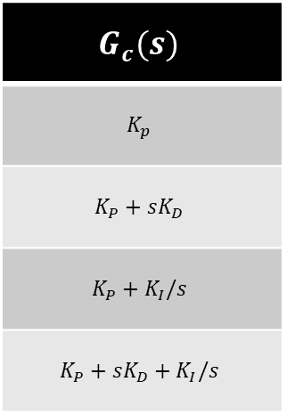
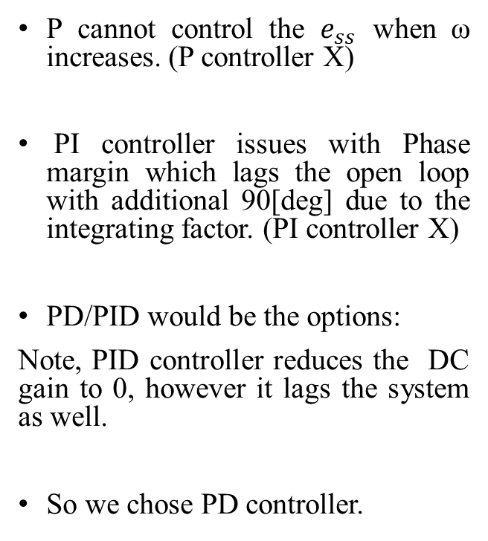
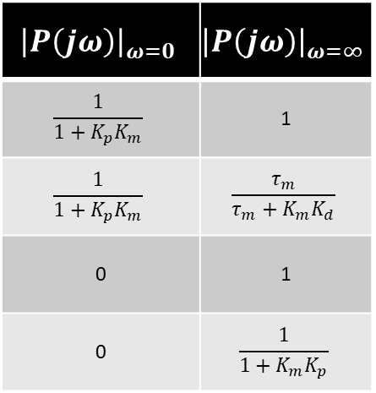
Overall consideration:
P cannot control the $e_{ss}$ when ω increases. (P controller X)
PI controller issues with Phase margin which lags the open loop with additional 90[deg] due to the integrating factor. (PI controller X)
PD/PID would be the options:
Note, PID controller reduces the DC gain to 0, however it lags the system as well.
So we chose PD controller.
$$G_{c}(s)$$
$$K_{p}$$
$$K_{P}+sK_{D}$$
$$K_{P}+K_{I}/s$$
$$K_{P}+sK_{D}+K_{I}/s$$
$${\left|P\left(jω\right)\right|}_{ω=0}$$ | $${\left|P\left(jω\right)\right|}_{ω=∞}$$
$$\frac{1}{1+K_{p}K_{m}}$$ | 1
$$\frac{1}{1+K_{p}K_{m}}$$ | $$\frac{τ_{m}}{τ_{m}+K_{m}K_{d}}$$
0 | 1
0 | $$\frac{1}{1+K_{m}K_{p}}$$

